Slide 1
GGC Library Management System
Project Title

Slide 2
Group Members
Muhammad Shahzaib Afzal (19721556-017)
Nouman Aziz (19721556-046)
Mehran Ali (19821556-002)
Supervised By:
Miss Faiza Rasheed

Slide 3

Problem Statement
The existing system of GGC Library is totally manual that why it’s difficult to manage the all the library affairs include books management, student record management and transaction management.
The manual library system was a time-consuming process and required a lot of effort from the librarians.
The librarians have to manually enter the details of the books in the register, and they have to manually update the register when the books are returned.

Slide 4

Proposed Solution
Proposed Library Management System is a Computer-based system that helps in managing and organizing the resources of a library, and the specific requirements and features would vary depending on the context and needs of the institutions implementing it.
Interactive and Engaging Features.
Integration of Library functions in a systematic way.
Fast and Effortless gathering of all information in the library.
Web-Based System.
Efficient management of the library. .

Slide 5




Tools and technologies used
Visual studio code (targeted platform and used in many different professional developers app).
React JS framework
JavaScript
Node.js (for backend development).
MongoDB database (for saving and retrieval of records)

Slide 6


Modules
Admin:
Manage Students
Manage Faculty Staff
Manage Books
Manage Transactions
View Details
Generate Reports
Maintain Records

Slide 7

Modules
Student:
Login
Profile setup
Search books
View book details
Reserve books
Borrow books
Renew books
Read Ebooks

Slide 8
Modules
Staff:
Login
Profile setup
Search books
View books details
Reserve books
Borrow books
Renew books
Read books

Slide 9
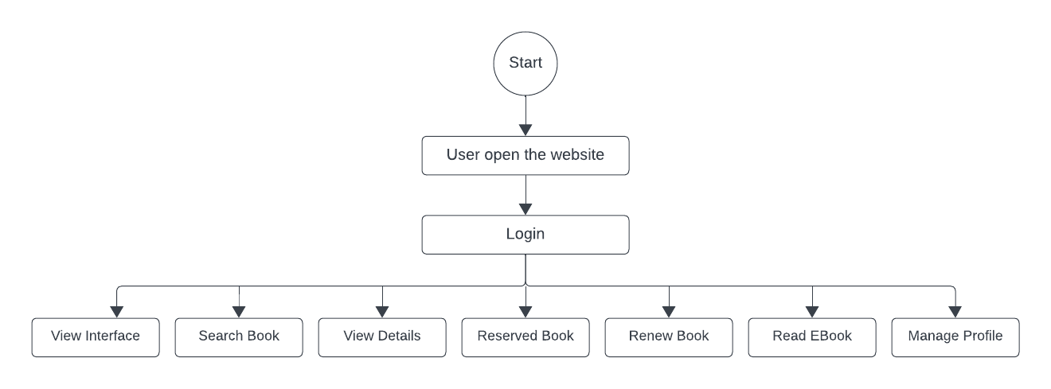
Web Demonstration
User:

Slide 10
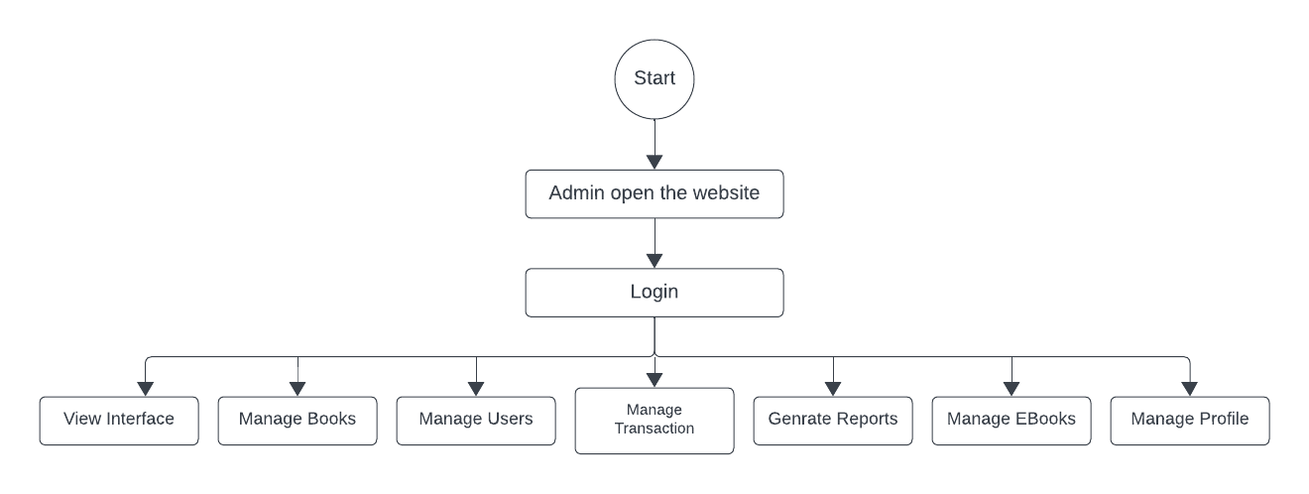
Web Demonstration
Admin:

Slide 11
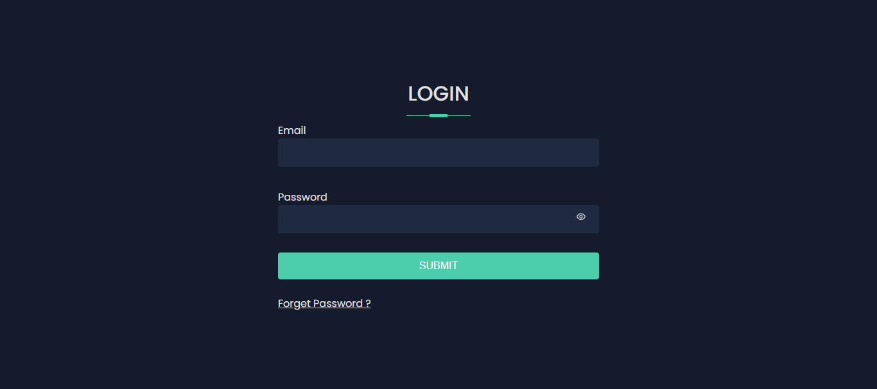

Web Interface:

Slide 12
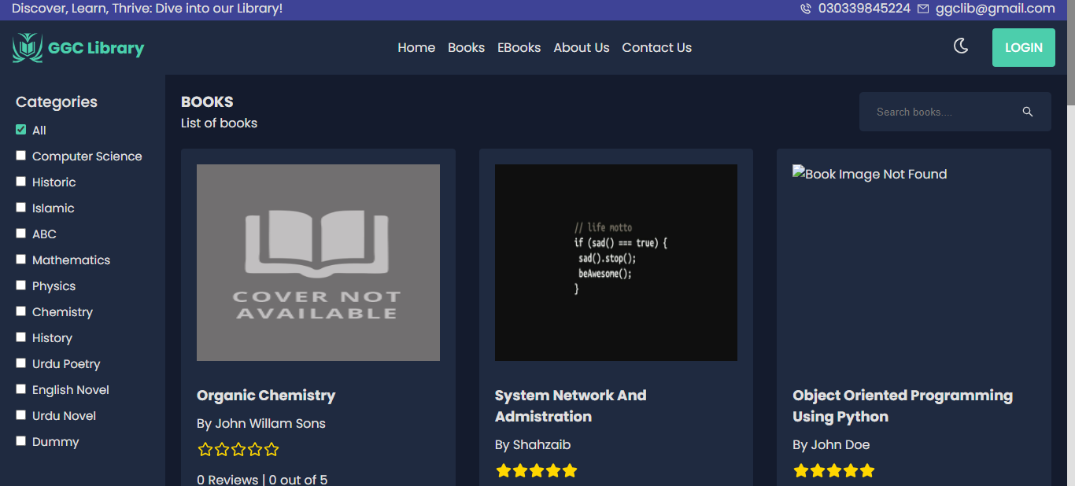
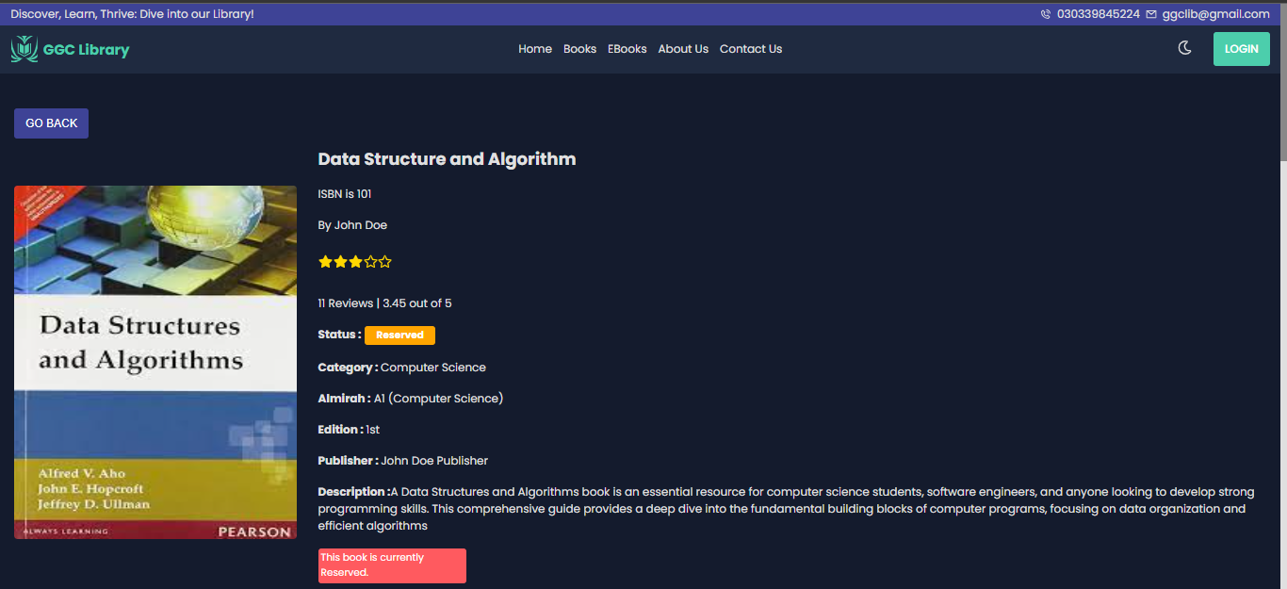
Web Interface:

Slide 13
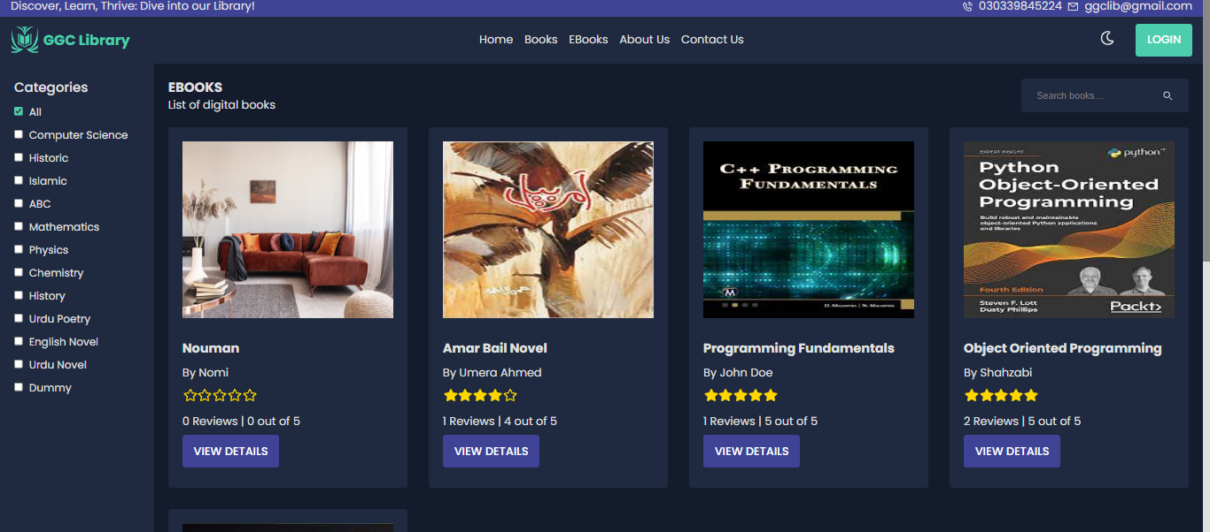
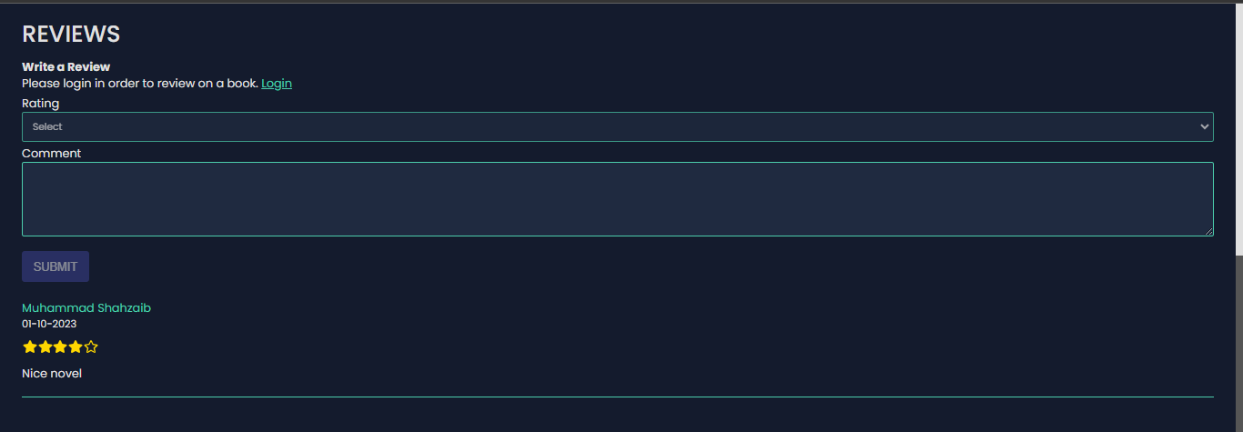
Web Interface:

Slide 14
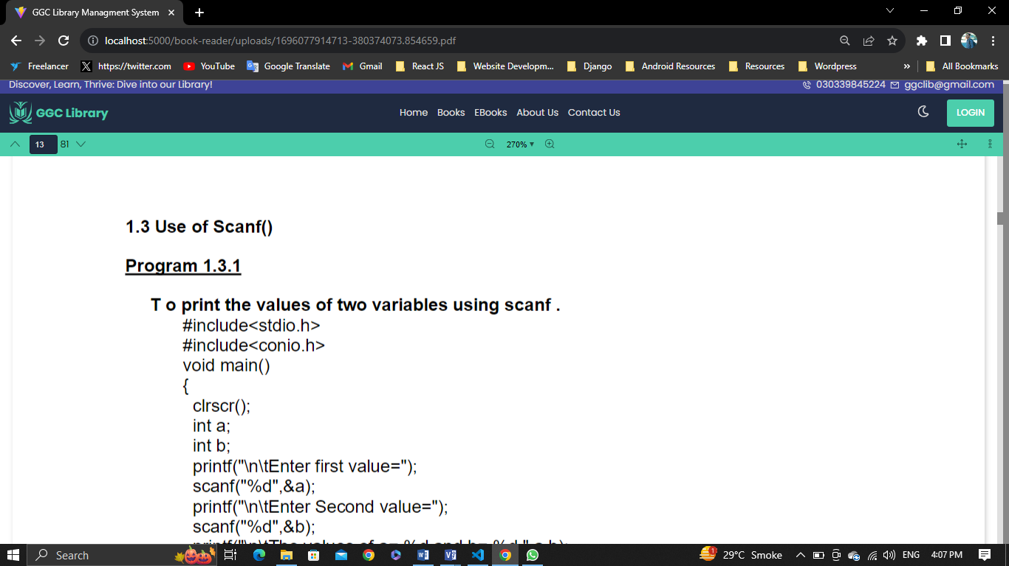
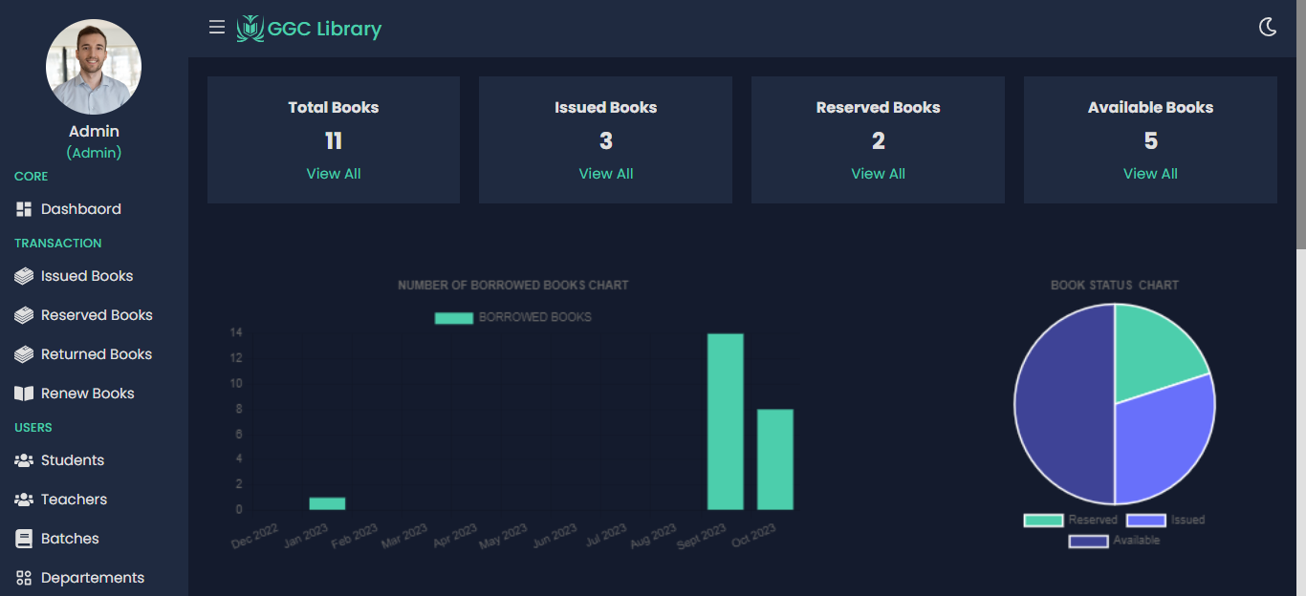
Web Interface:

Slide 15
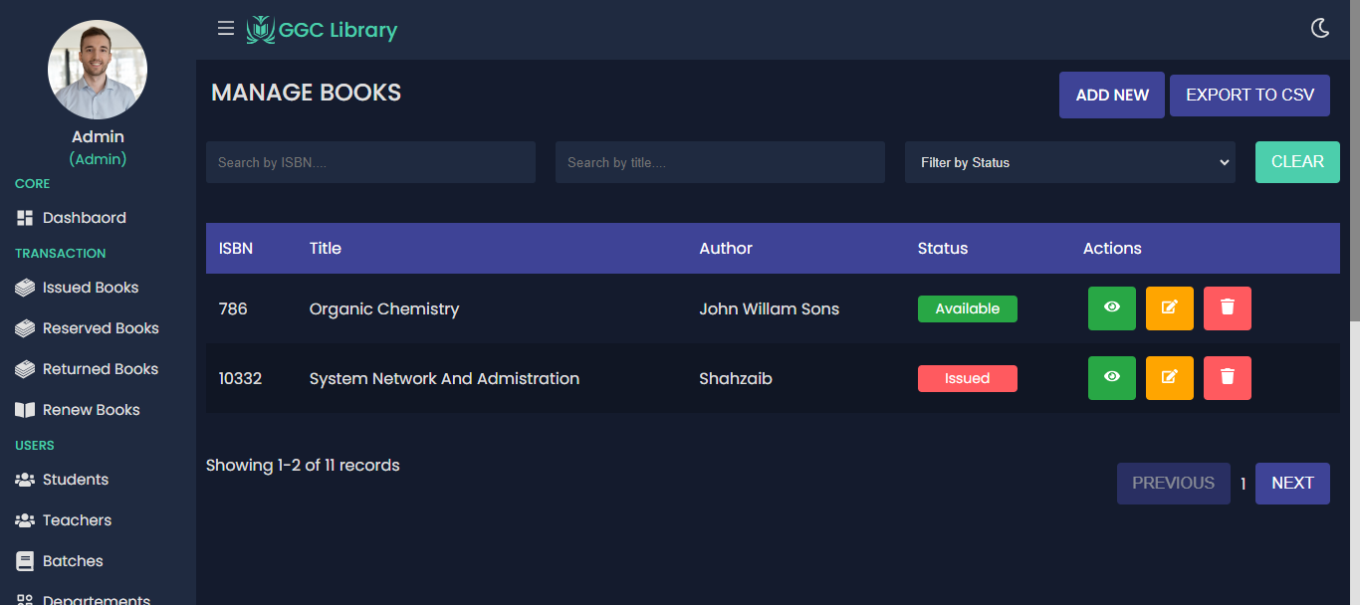
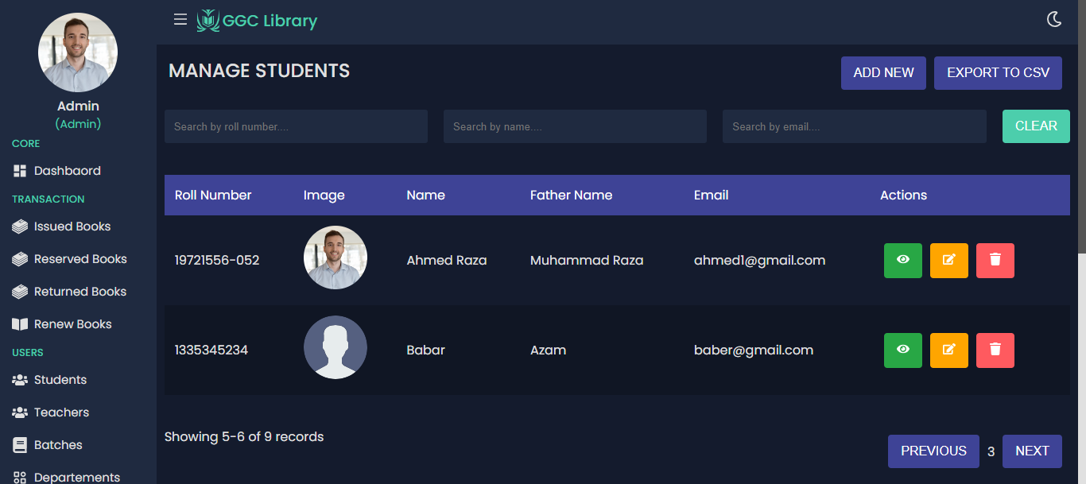
Web Interface:

Slide 16
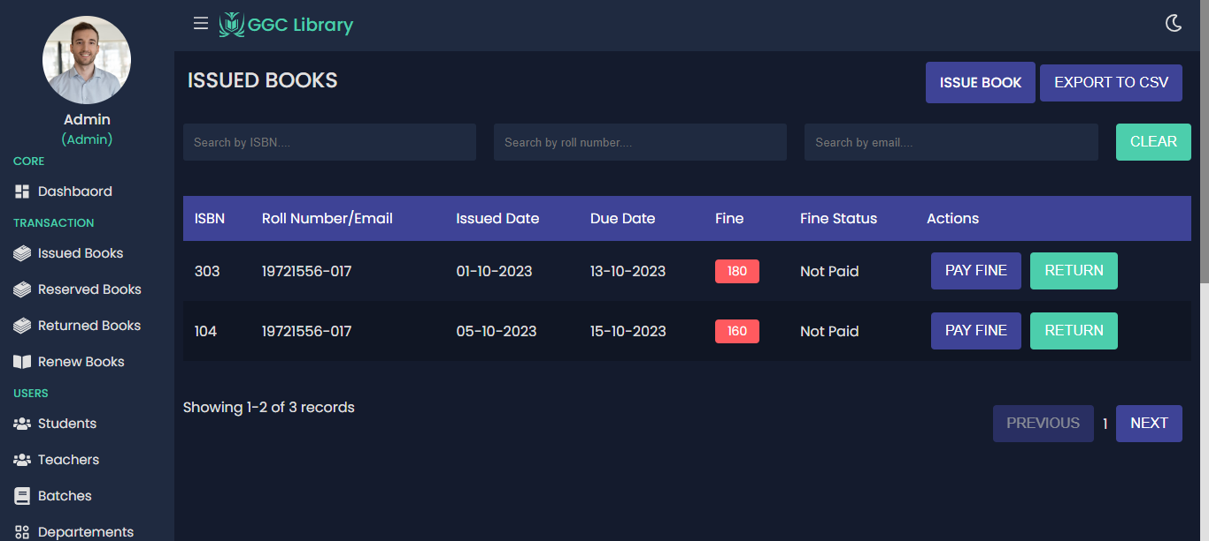
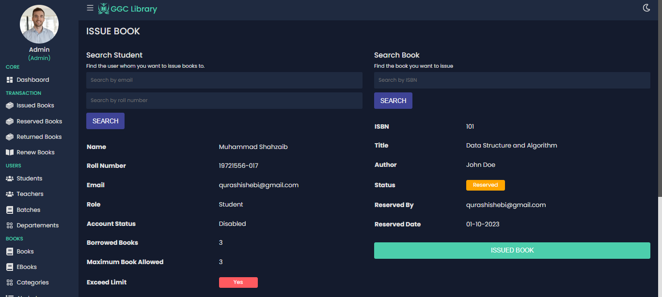
Web Interface:

Slide 17
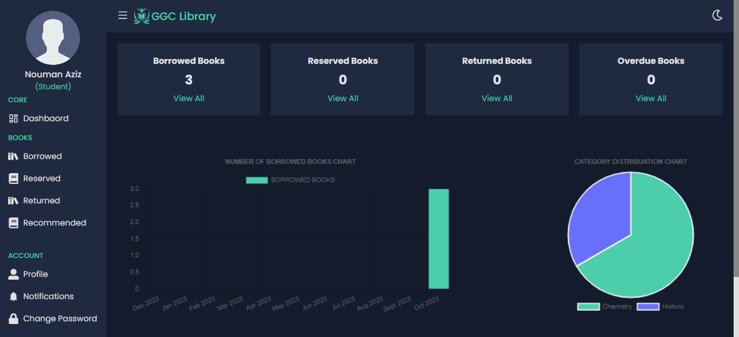
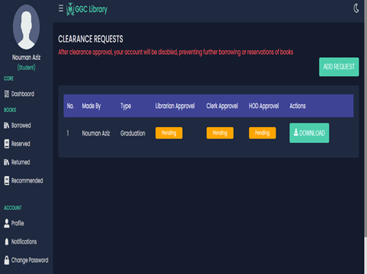
Web Interface:

Slide 18
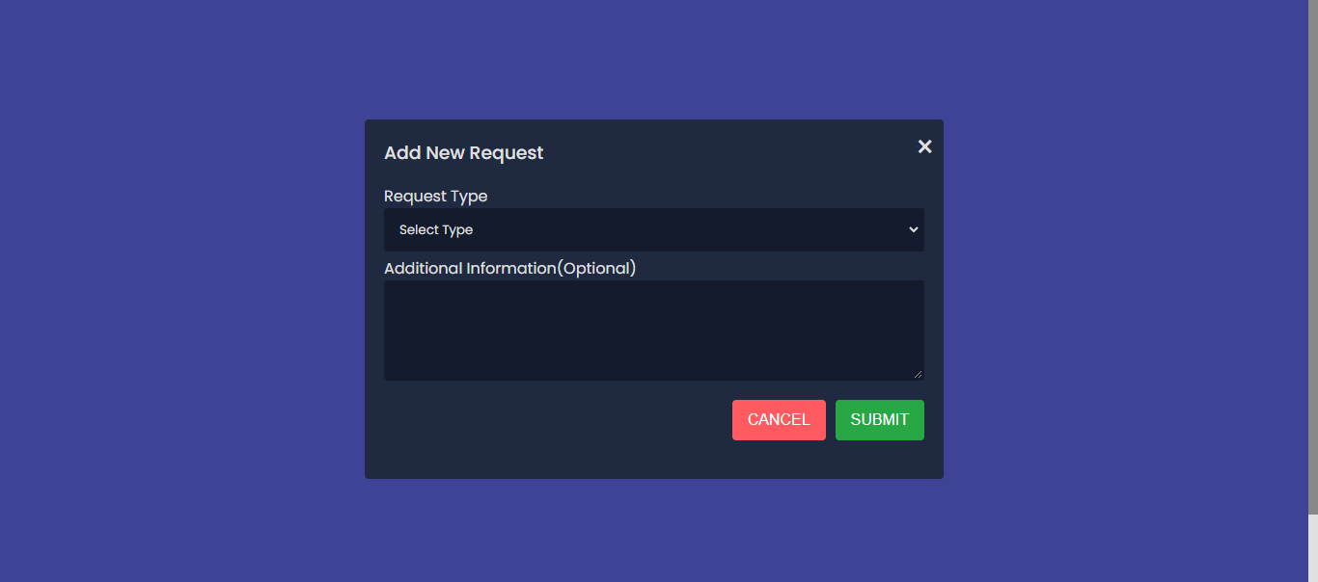
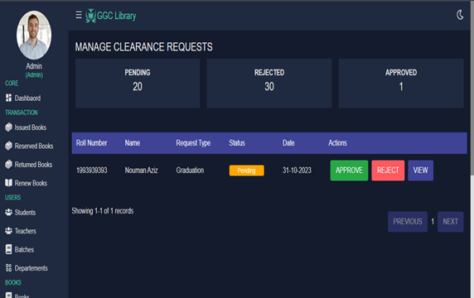
Web Interface:

Slide 19
THANK YOU

